Slide 1
BOYS & GIRLS TRACK PARENT MEETING
COACH CARLSON - Girls Side
BOYS SIDE - TBD
Coach Zassenbraker – THROWERS

Slide 2
TRYOUTS
March 5th – 7th 3PM-4:40PM
JLMS TRACK – After School
CLOSED TRY-OUT
NO CARS PARKED BY TRACK

Slide 3
TRYOUTS
Running Shoes
Shorts/T-Shirt – P.E. Style
Stay in dress code for tryout
Water/Snack if needed
It is a Tryout NOT SOCIAL TIME

Slide 4
TRYOUTS
DEPENDING ON NUMBERS CUTS MAY BE MADE AFTER 2nd DAY.
NO GUARANTEED SPOTS
24 HOUR RULE
LET STUDENT APPROACH COACH
Largest M.S. Can’t take everyone

Slide 5
TRYOUTS
TIMED RACES - Groups of 6
100m
300m
1200m
Coach Z with Throwers
Can tryout for all events

Slide 6
ATHLETIC FORMS
School Website:
-Click on Athletics
- Click on Sports Participation Requirements
- Click on Sports Physical
(MUST COMPLETE ALL FORMS)
Concussion Video: complete and print certificate
Notary –We have some here at school
Medicals- Medexpress $30 & Fast Track

Slide 7
Page 1

Slide 8
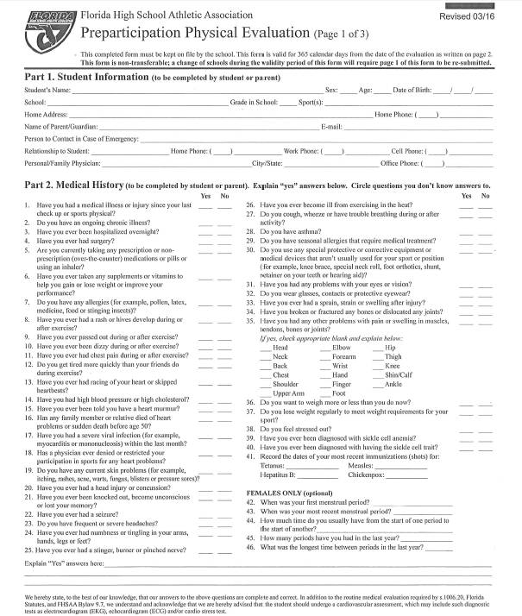
Page 2

Slide 9
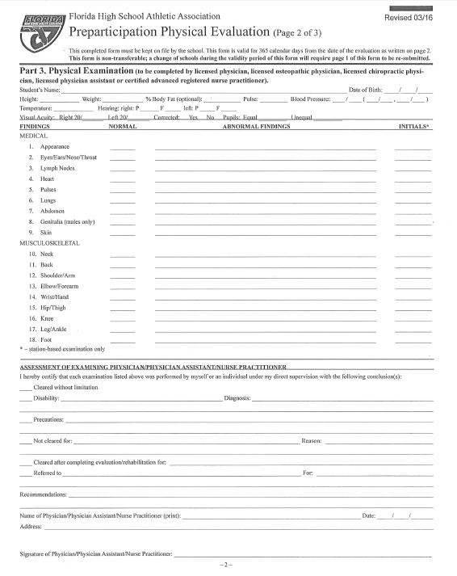
Page 3

Slide 10
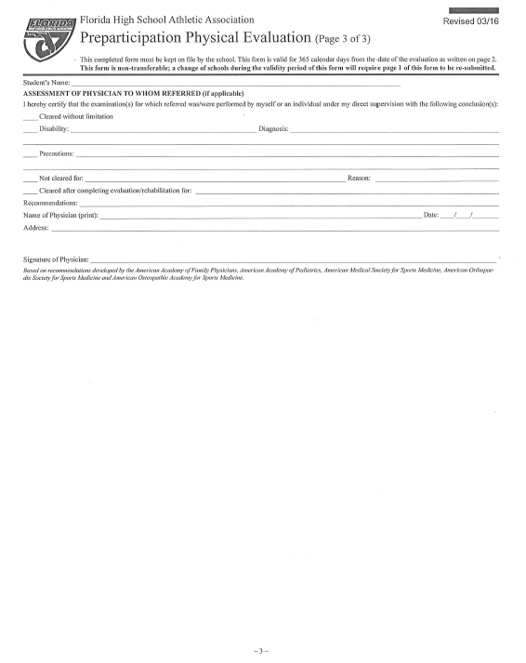
Page 4

Slide 11
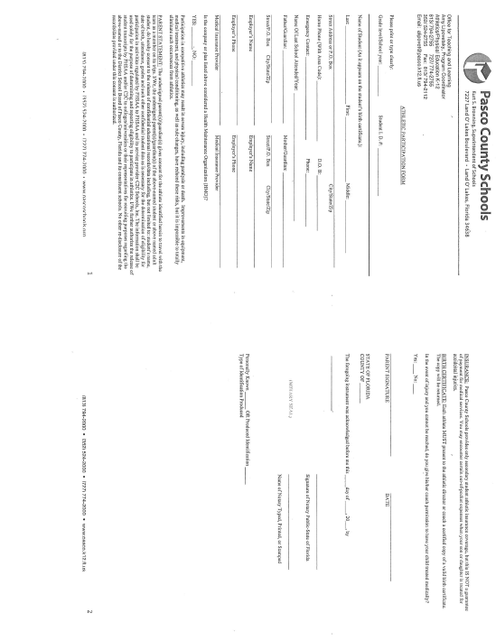
Page 5

Slide 12
Page 6

Slide 13
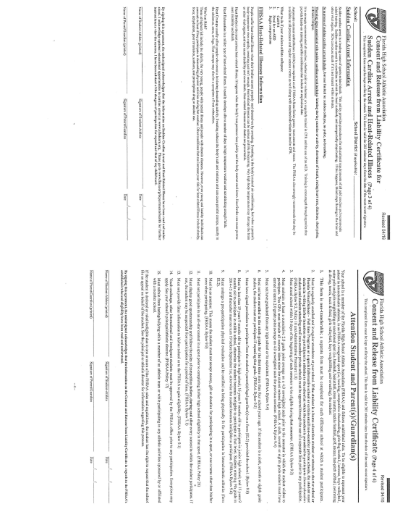
Page 7

Slide 14
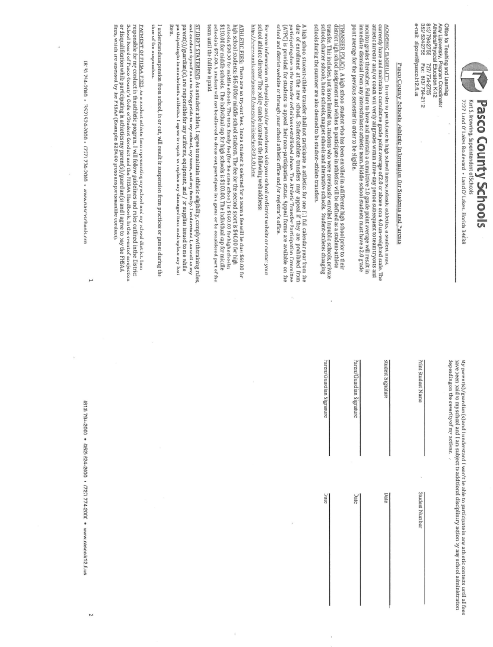
Page 8

Slide 15
GRADES
Eligibility- 1st semester grades from FALL 2017 to tryout.
Teacher recommendations may be part of tryouts
Must maintain C or better grades during season,

Slide 16
TRACK MEETS
THURSDAY MARCH 29th - @ SLHS
THURSDAY APRIL 5th - @ WRHS
MONDAY APRIL 9th @ PHS
THURSDAY APRIL 12th @ WRHS
(WRHS DATES MAY CHANGE)
THURSDAY APRIL 19th @ CCHS CONFERENCE CHAMPIONSHIPS

Slide 17
TRACK MEETS
Track Meets start at 5:30pm
FIELD EVENTS – DISCUS / SHOTPUT
HIGH JUMP / LONG JUMP
RUNNING EVENTS FOLLOW
Hurdles/100m/1600m/4x100 Relay
400/800m/200m/Medley

Slide 18
TRACK MEETS
Bus Provided For Away Meets
Students stay after school
Bring Meal/Snack – Do Homework
Parents can drive athlete to MEETS
Parents can take athlete Home after MEETS
Or Parents can pick athlete up at JLMS after Meets

Slide 19
PRACTICES
Mon - Thurs 3:00pm – 4:30pm unless told otherwise. Please pick up your child on time or make other arrangements.
Parents late picking child up on 2 or more occasions can result in child not competing in an upcoming meet. (Coaches Decision)
Short Season – Long School Days- Please don’t make them longer than they have too.

