Slide 1
BOYS & GIRLS TRACK PARENT MEETING
COACH CARLSON - Sprinters/Jumpers
COACH FLETCHER- RELAYS
Coach Martin – Distance
Coach Zassenbraker – THROWERS

Slide 2
DAY 1. TRYOUTS
March 8th
100M & 1200M
JLMS TRACK – After School
CLOSED TRY-OUT
NO CARS PARKED BY TRACK

Slide 3
DAY 2 TRYOUT 300M /800M Tuesday, March 9th
AFTER SCHOOL (CLOSED TRYOUT)
3:20PM – 5:00PM @ JLMS TRACK
MAKE UP – 100M
ANYONE WHO MISSED ON THURSDAY
(NO REDO’s)
ONE OPPORTUNITY FOR EACH EVENT
THAT’S IT, NO EXCEPTIONS –
ONE CHANCE = SAME FOR EVERYONE
THROWERS WITH COACH ZASSENBRAKER

Slide 4
DAY 3 TRYOUT WEDNESDAY, MARCH 10th HURDLES/BROAD/VERT
LAST DAY
HURDLES ON GRASS
BROAD JUMP (LONG JUMPERS)
VERT POLE (HIGH JUMPERS)
MAKE UPS OF 100M / 300M / 1200M
FINAL CUTS MADE FOR BOYS AND GIRLS TEAMS

Slide 5
SHOTPUT/DISCUS TRYOUTS Coach Zassenbraker
MONDAY MARCH 8th – Shot/Discus Tutorial
To learn “How to Throw”
DISCUS TRYOUT IS ON MARCH 10th
SHOT PUT TRYOUT IS ON MARCH 9th
SEE COACH ZASSENBRAKER FOR MORE DETAILS
THROWERS Can Be Runners as well
dzassenb@pasco.k12.fl.us if you have questions

Slide 6
TRYOUTS
Running Shoes
Shorts/T-Shirt – P.E. Style
Stay in dress code for tryout
Water/Snack if needed
It is a Tryout NOT SOCIAL TIME

Slide 7
TRYOUTS
NO GUARANTEED SPOTS
Must have Paperwork complete
24 HOUR RULE
LET STUDENT APPROACH COACH
Can’t take everyone,

Slide 8
TRYOUTS
TIMED RACES - Groups of 6
100m
300m
800M/1200m (OPEN ENTRIES)
Coach Z with Throwers
Can tryout for all events

Slide 9
ATHLETIC FORMS
School Website:
-Click on Athletics
- Click on Sports Participation Requirements
- Click on Sports Physical
(MUST COMPLETE ALL FORMS)
3 Videos: Complete Courses and print certificate to turn in with packet.
Notary –We have some here at school
Medicals- Medexpress $30 & Fast Track
COVID WAIVER

Slide 10
Physical Forms On JLMS Website
https://jlms.pasco.k12.fl.us/

Slide 11
Page 1

Slide 12
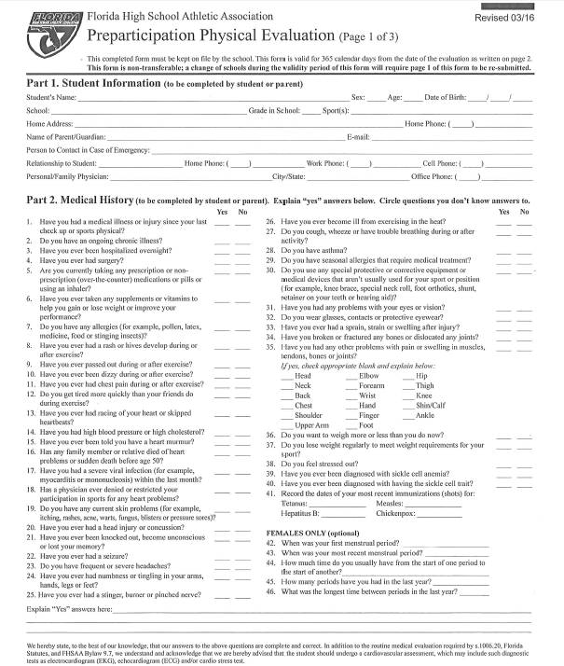
Page 2

Slide 13
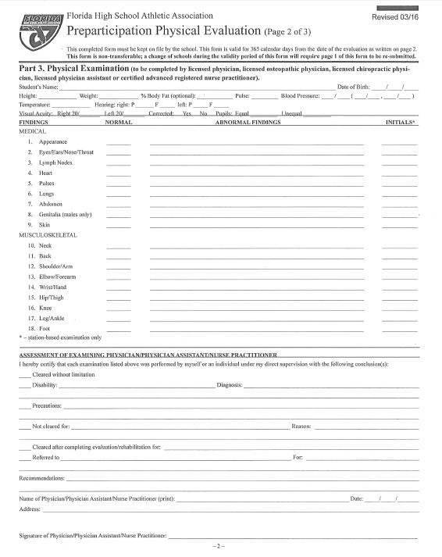
Page 3

Slide 14
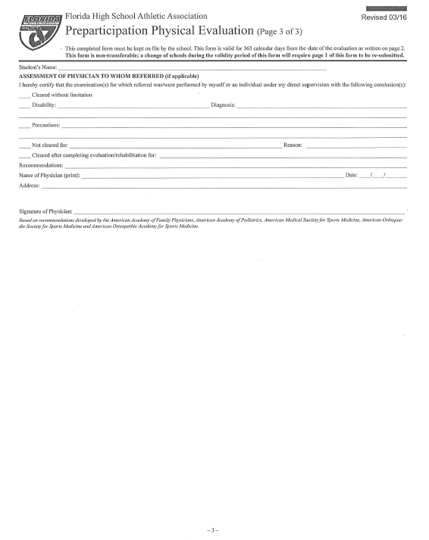
Page 4

Slide 15
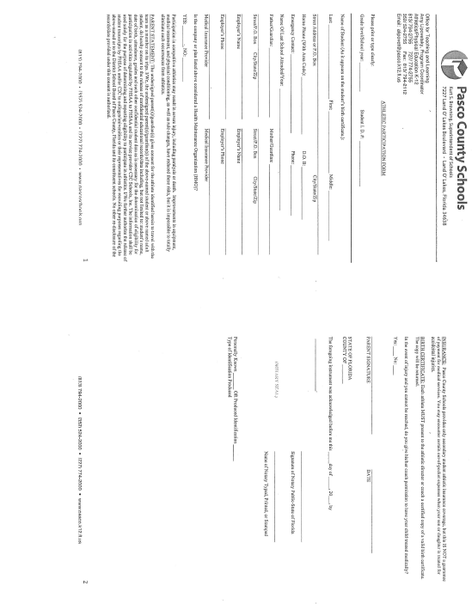
Page 5

Slide 16
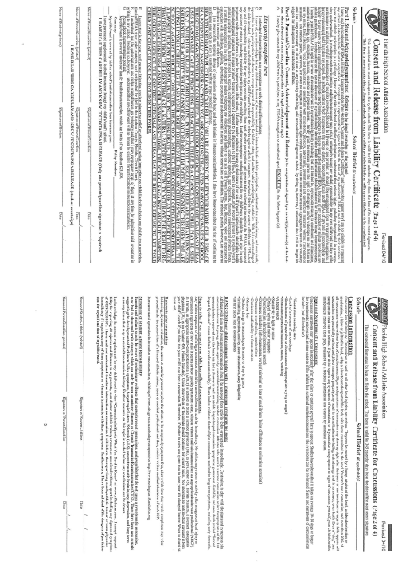
Page 6

Slide 17
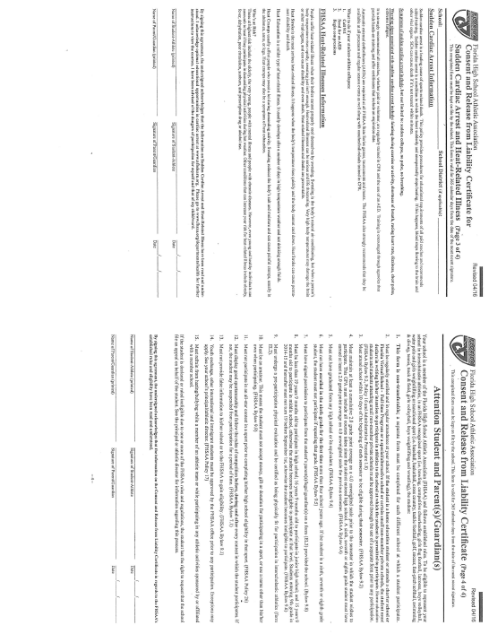
Page 7

Slide 18
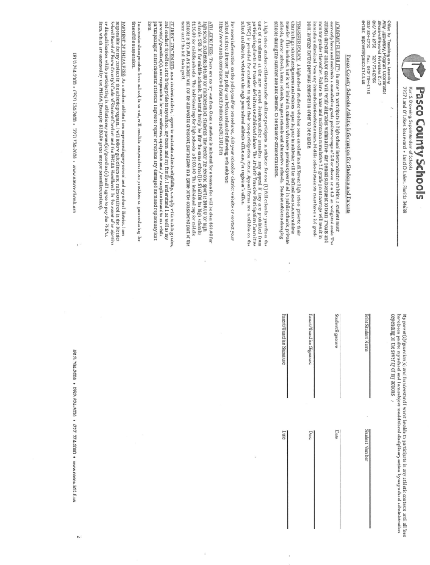
Page 8

Slide 19
GRADES
Eligibility- 1st semester grades from FALL 2020 to tryout.
Teacher recommendations may be part of tryouts
Must maintain C or better grades during season,

Slide 20
TRACK MEETS
TUESDAY APRIL 6th - @ WRHS
THURSDAY APRIL 8th- @ LOLHS
THURSDAY APRIL 15th @ SLHS
THURSDAY APRIL 22nd @ ZHS
TUESDAY APRIL 29th @ CCHS CONFERENCE CHAMPIONSHIPS

Slide 21
TRACK MEETS
Track Meets start at 5:30pm
FIELD EVENTS –
G -DISCUS / B -SHOTPUT
G - HIGH JUMP / B - LONG JUMP
RUNNING EVENTS FOLLOW
Hurdles/100m/1600m/4x100 Relay
400M/800m/200m/Medley

Slide 22
TRACK MEETS
Bus Provided For Away Meets
Students stay after school
Bring Meal/Snack – Do Homework
Parents can drive athlete to MEETS
Parents can take athlete Home after MEETS
Or Parents can pick athlete up at JLMS after Meets

Slide 23
PRACTICES
Mon - Thurs 3:20pm – 4:45PM unless told otherwise. Please pick up your child on time or make other arrangements.
Parents late picking child up on 2 or more occasions can result in child not competing in an upcoming meet. (Coaches Decision)
Short Season – Long School Days- Please don’t make them longer than they have too.

